Slide 1
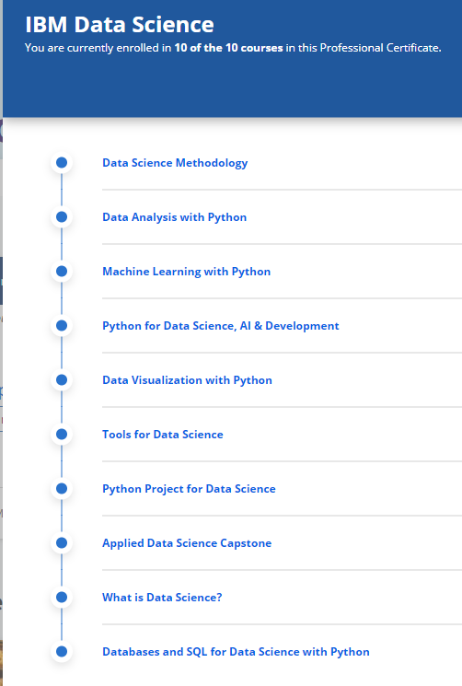






Applied Data Science Capstone Report
Wilson Ashimwe
06 August 2021

Slide 2



OUTLINE
Executive Summary
Introduction
Methodology
Results
Visualization – Charts
Dashboard
Discussion
Findings & Implications
Conclusion
Appendix

Slide 3

EXECUTIVE SUMMARY
This report discusses summarizes the results of project aiming to provide students who doing the IBM Data Science Professional Certificate skills and knowledge to take on a real-world data science project. This project exploited data on space lockets. Falcon 9 is advertised by SpaceX a lower cost (62 million dollars) compared to other providers because SpaceX can reuse the first stage resulting in a lower cost. Therefore, determining if the first stage will land, allows to determine the cost of a launch. This information can be used if an alternate company wants to bid against SpaceX for a rocket launch. In this project, I determined the price of each launch gathered information about Space X and created dashboards to visualize the data. In addition, I determined if SpaceX would reuse the first stage. Various machine learning algorithms were used to train a machine learning model and use public information to predict if SpaceX will reuse the first stage.

Slide 4

INTRODUCTION
The final course of the Data Science Professional Certificate consists of a capstone project where in all the skills and relevant knowledge that one has gathered from these 9 intense courses has to be applied on a final capstone project.
During the capstone project, different data analysis, data visualization and machine learning packages were used to train a machine learning model and use public information to predict if SpaceX will reuse the first stage. These include Pandas, Matplotlib, Seaborn, Folium, Plotly, and Sklearn packages. This report discusses summarizes the results of the project.

Slide 5
INTRODUCTION 2
The aim of the project was to predict if the Falcon 9 first stage will land successfully. Falcon 9 is advertised by SpaceX a lower cost (62 million dollars) compared to other providers because SpaceX can reuse the first stage resulting in a lower cost. Therefore, determining if the first stage will land, allows to determine the cost of a launch. This information can be used if an alternate company wants to bid against SpaceX for a rocket launch.
In this project, I determined the price of each launch gathered information about Space X and created dashboards to visualize the data. In addition, I determined if SpaceX would reuse the first stage. Various machine learning algorithms were used to train a machine learning model and use public information to predict if SpaceX will reuse the first stage.

Slide 6

METHODOLOGY : Data Wrangling
An in-depth research of the dataset has been done and a thorough analysis of the various features and methods have been investigated to ensure the maximum accuracy of the model as possible.
Data wrangling was performed to get a dataset that could be used for further analysis. In the data set, there are several different cases where the booster did not land successfully. Those outcomes were converted into training Labels with 1 meaning the booster successfully landed and meaning it was unsuccessful.
See the Class column below

Slide 7
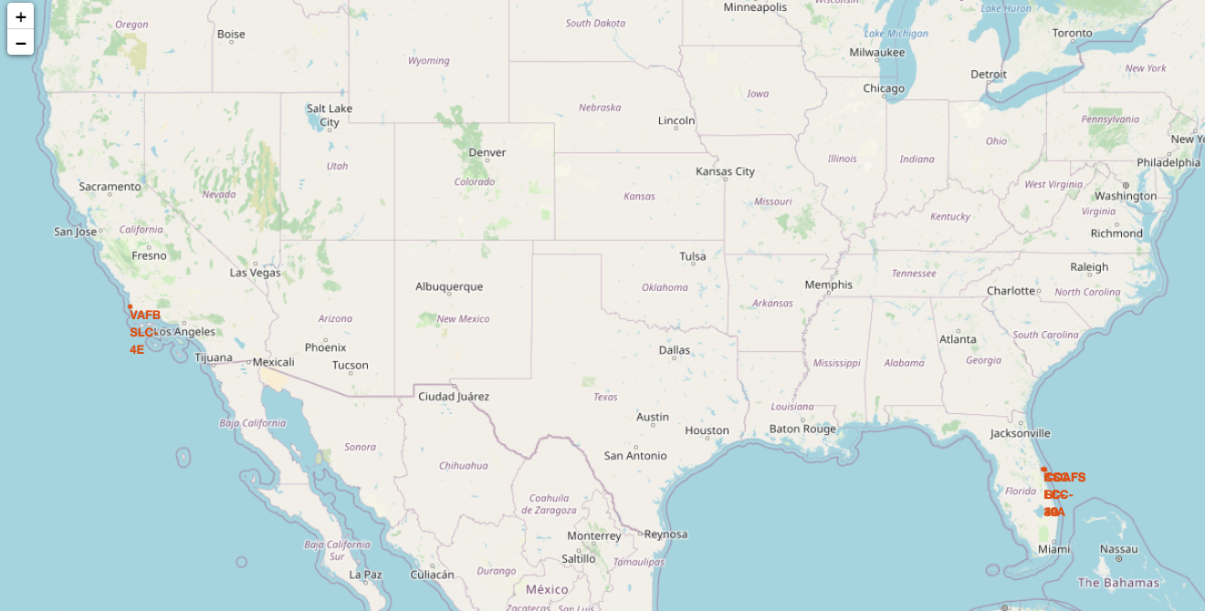
METHODOLOGY: interactive visual analytics
An exploratory analysis was done using SQL and then interactive visual analytics were performed using packages including Folium and Plotly.
Folium makes it easy to visualize geolocation data .
Please see below a map with marked launch sites

Slide 8
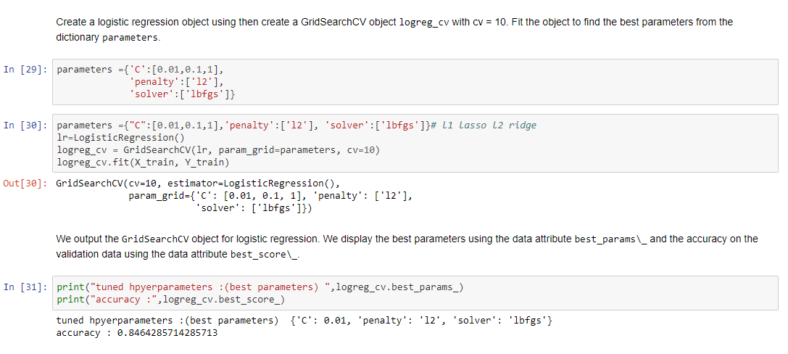
METHODOLOGY: predictive analysis
Various machine learning algorithms were used to train a machine learning model and use public information to predict if SpaceX will reuse the first stage.
The figure below shows on of the machine learning model

Slide 9
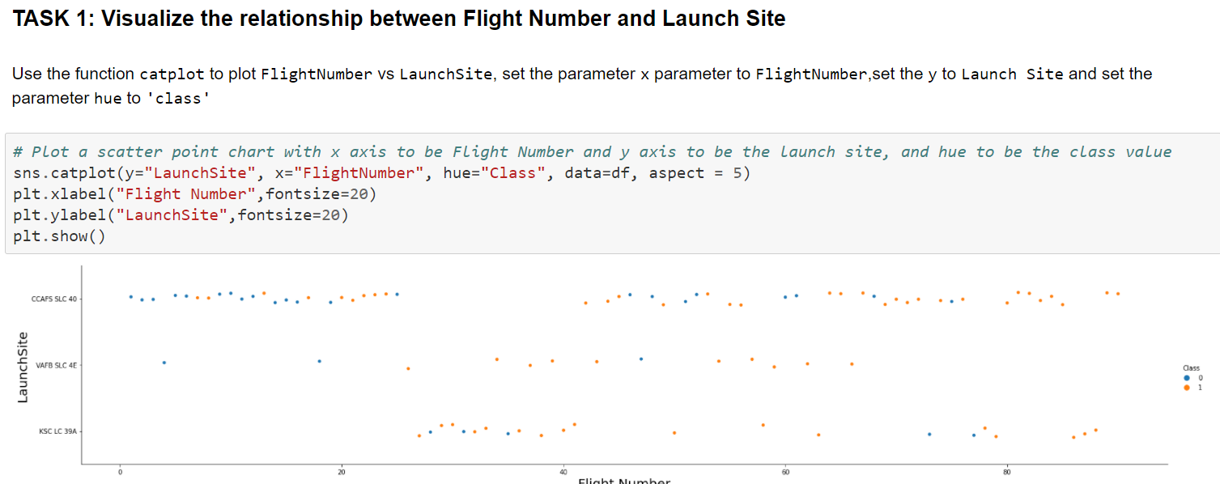
RESULT: EDA with visualization results: Task 1

Slide 10
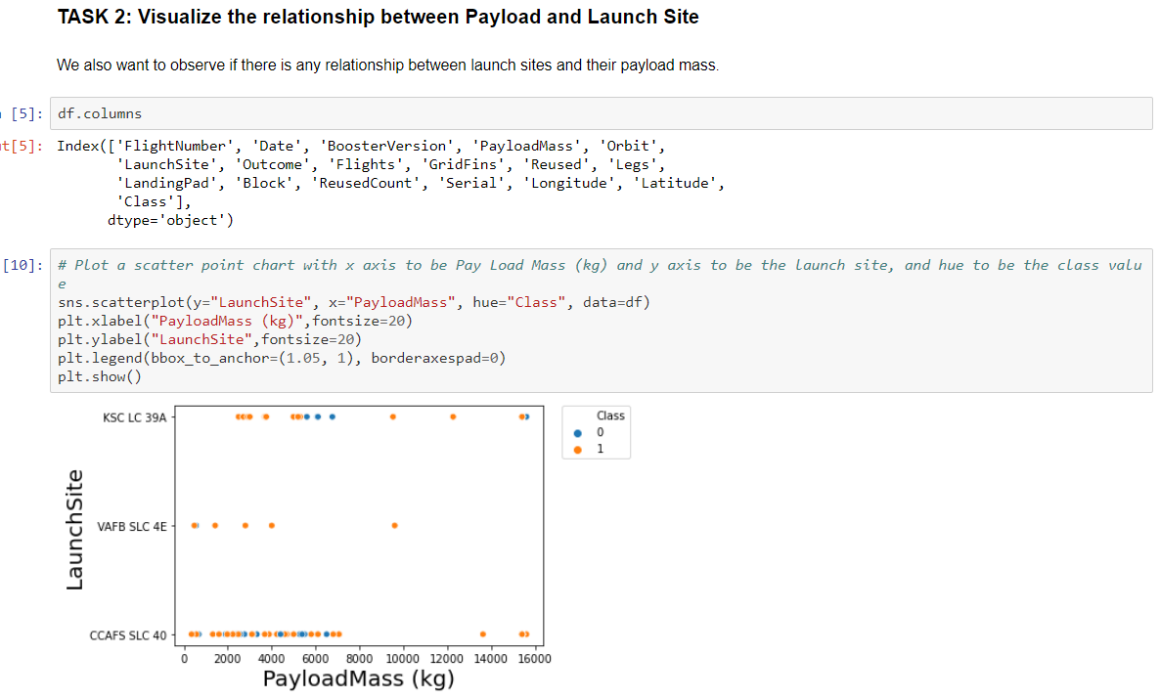
RESULT: EDA with visualization results: Task 2

Slide 11
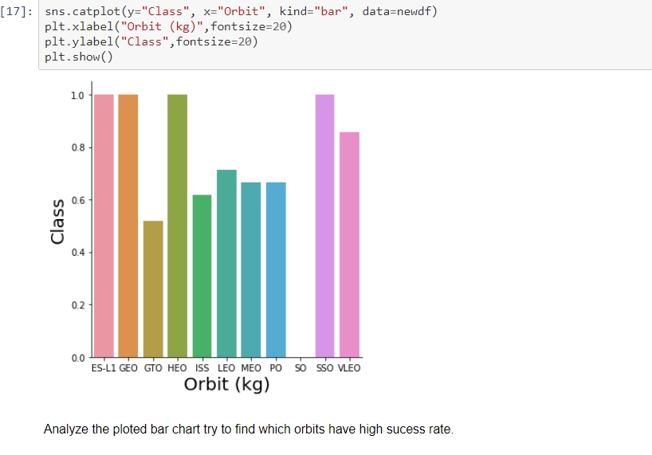
RESULT: EDA with visualization results: Task 3

Slide 12
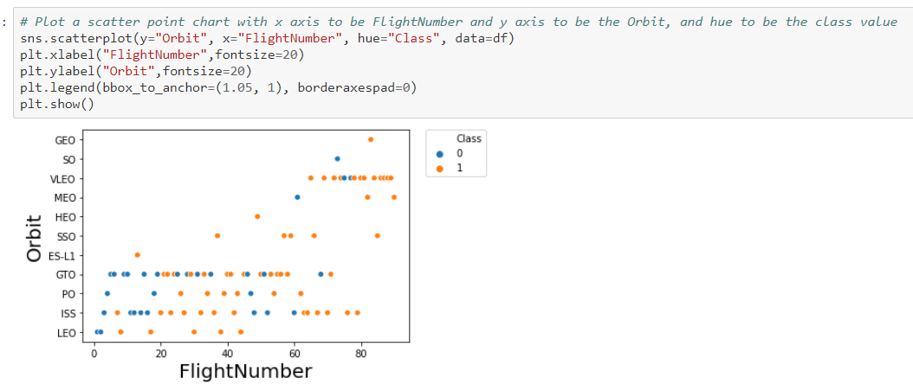
RESULT: EDA with visualization results: Task 4

Slide 13
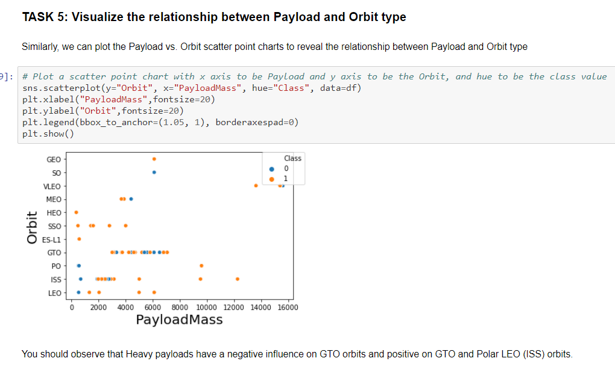
RESULT: EDA with visualization results: Task 5

Slide 14
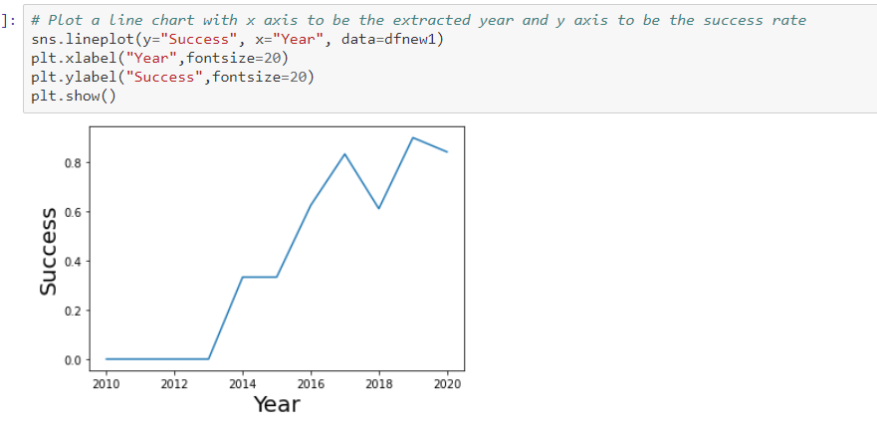
RESULT: EDA with visualization results: Task 6

Slide 15
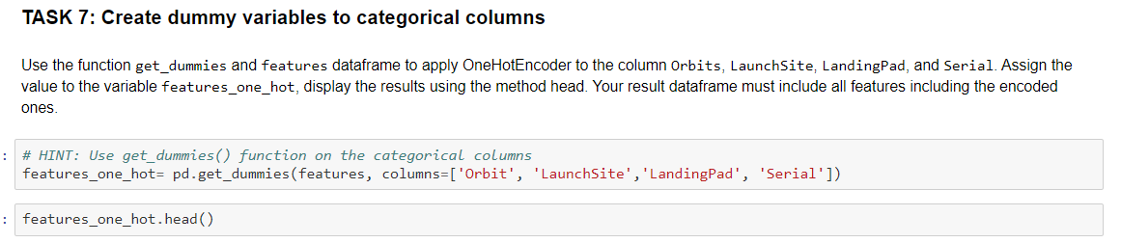
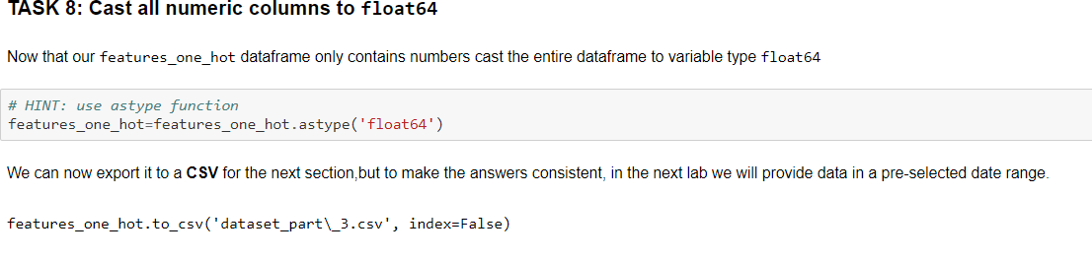
RESULT: EDA with visualization results: Task 7 and 8

Slide 16
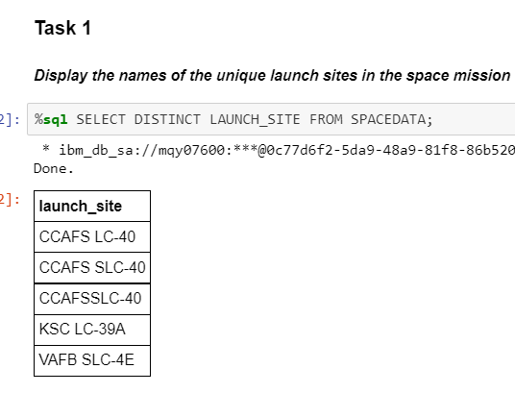
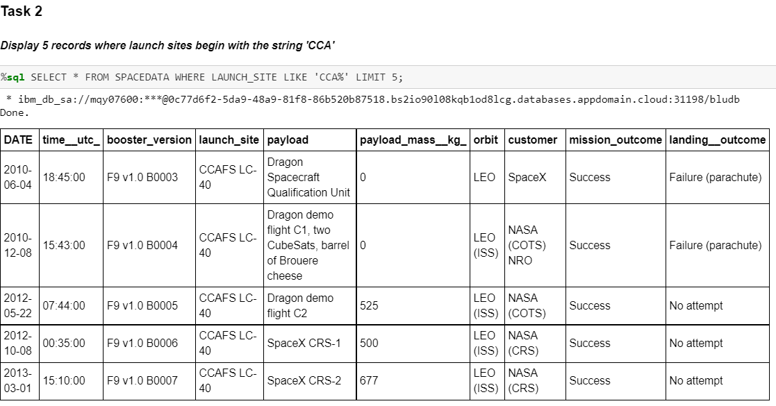
RESULT: EDA with SQL results slides: Task 1 and 2

Slide 17
RESULT: EDA with SQL results slides: Task 1 and 2

Slide 18
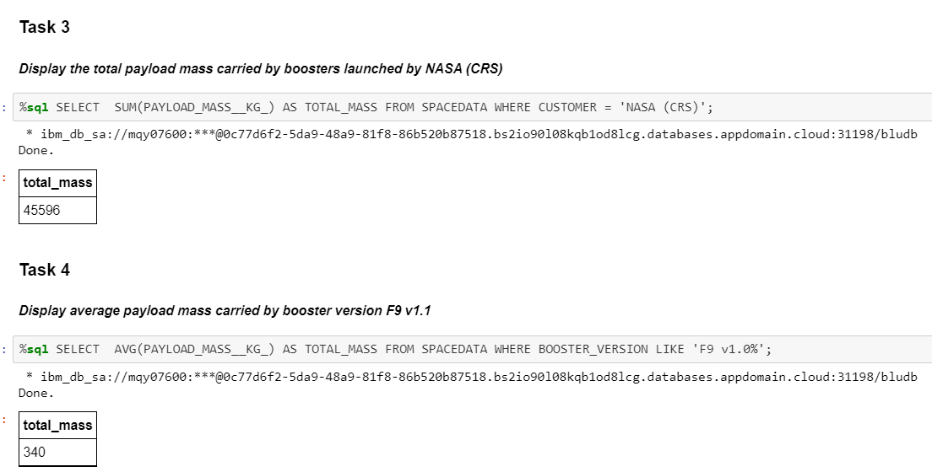
RESULT: EDA with SQL results slides: Task 3 and 4

Slide 19
RESULT: EDA with SQL results slides: Task 3 and 4

Slide 20
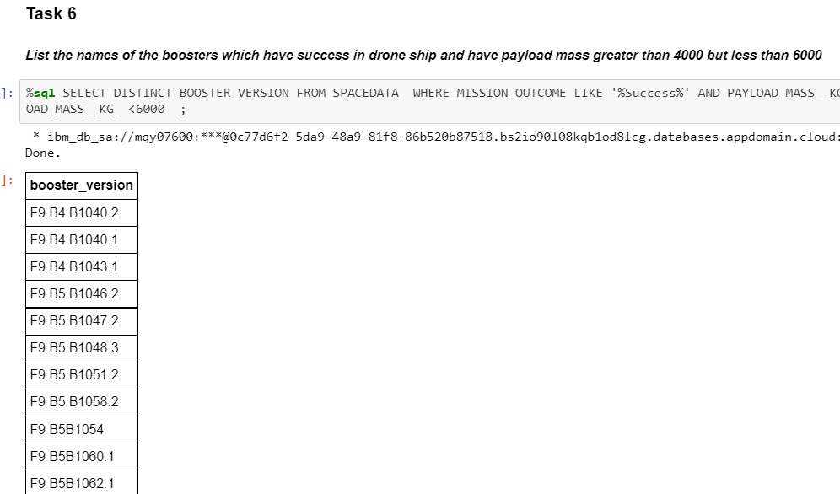
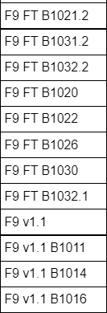
RESULT: EDA with SQL results slides: Task 6

Slide 21
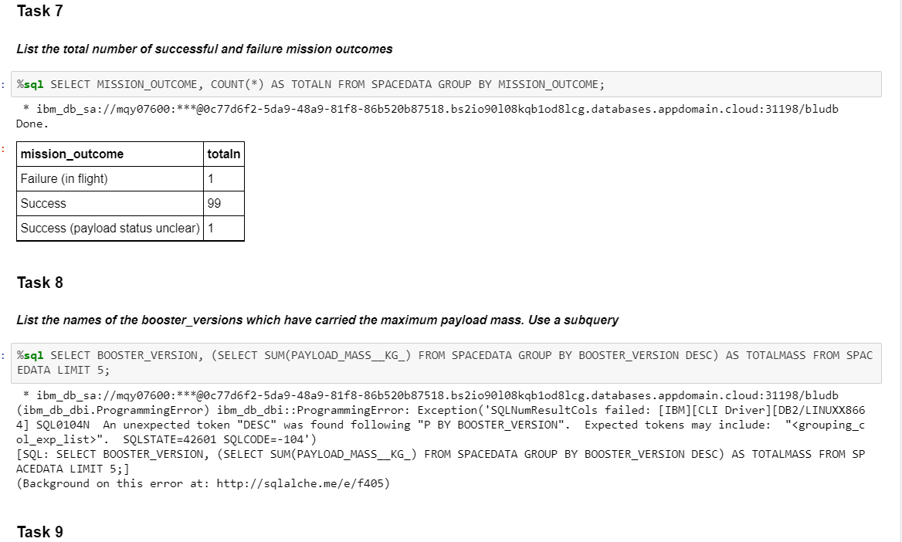
RESULT: EDA with SQL results slides: Task 7 and 8

Slide 22
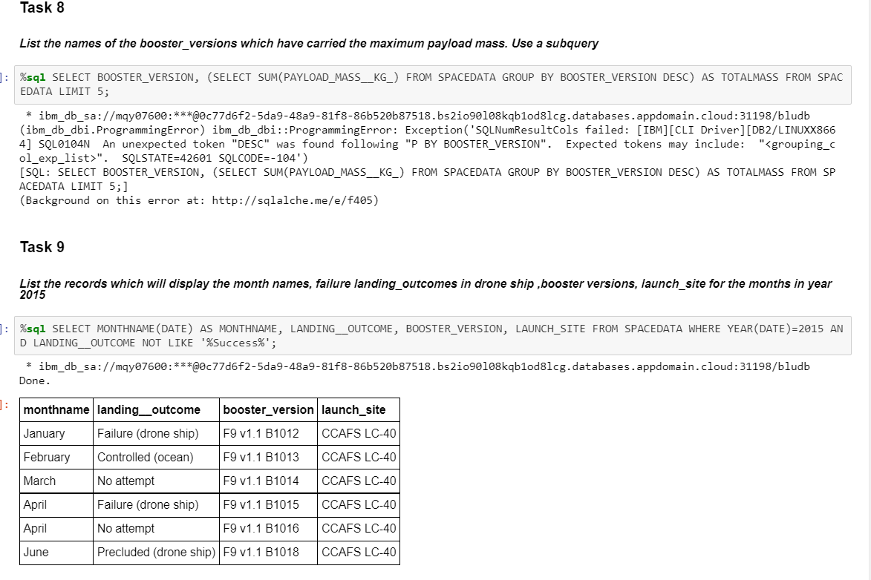
RESULT: EDA with SQL results slides: Task 8 and 9

Slide 23
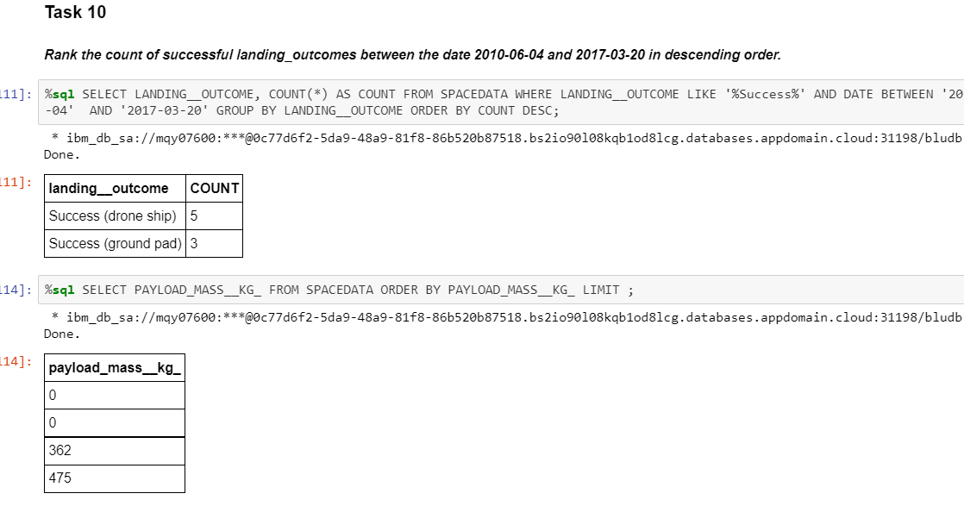
RESULT: EDA with SQL results slides: Task 10

Slide 24
RESULT: interactive map with Folium results : Task 1
site_map = folium.Map() for lat,lgt,site in zip(launch_sites_df['Lat'], launch_sites_df['Long'], launch_sites_df['Launch Site']): # For each launch site, add a Circle object based on its coordinate (Lat, Long) values. In addition, add Launch site name as a popup label circle = folium.Circle([lat,lgt], radius=100, color='#d35400', fill=True).add_child(folium.Popup(str(site))) # Create a blue circle at NASA Johnson Space Center's coordinate with a icon showing its name marker = folium.map.Marker( [lat,lgt], # Create an icon as a text label icon=DivIcon( icon_size=(20,20), icon_anchor=(0,0), html='<div style="font-size: 12; color:#d35400;"><b>%s</b></div>' % str(site), )) site_map.add_child(circle) site_map.add_child(marker) site_map

Slide 25
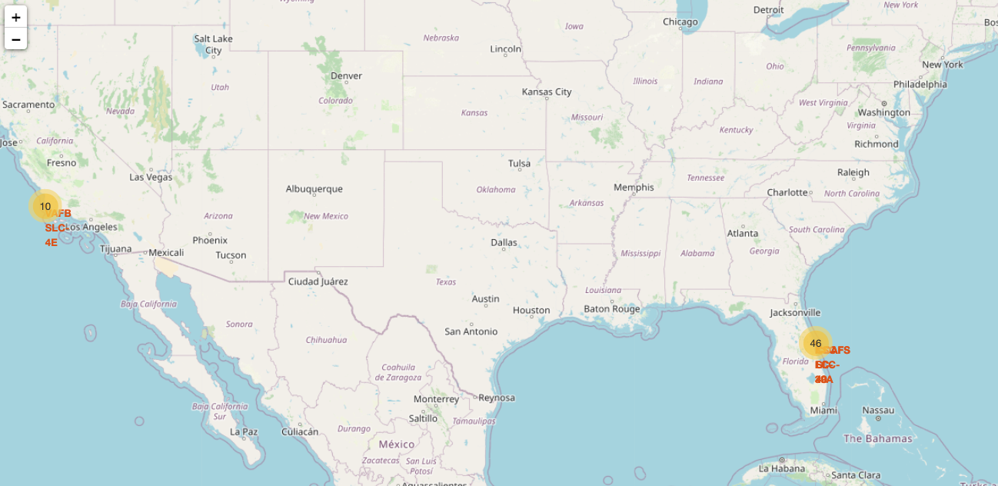
RESULT: interactive map with Folium results : Task 2
icons=[folium.Icon(icon="car", color='white', icon_color=color, prefix="fa") for _ in range(len(locations))] marker_cluster= MarkerCluster(locations=locations, icons=icons) site_map.add_child(marker_cluster) site_map

Slide 26
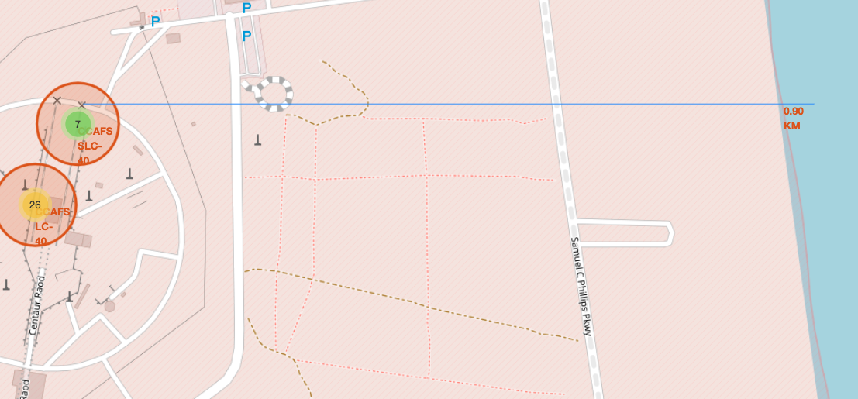
RESULT: interactive map with Folium results : Task 3

Slide 27
RESULT: interactive map with Folium results : Task 3

Slide 28
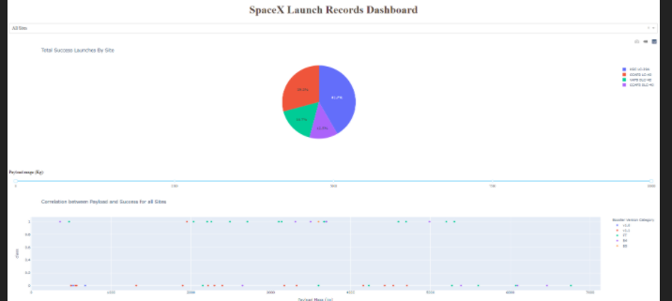
RESULT: Plotly Dash dashboard results :

Slide 29
RESULT: Plotly Dash dashboard :

Slide 30
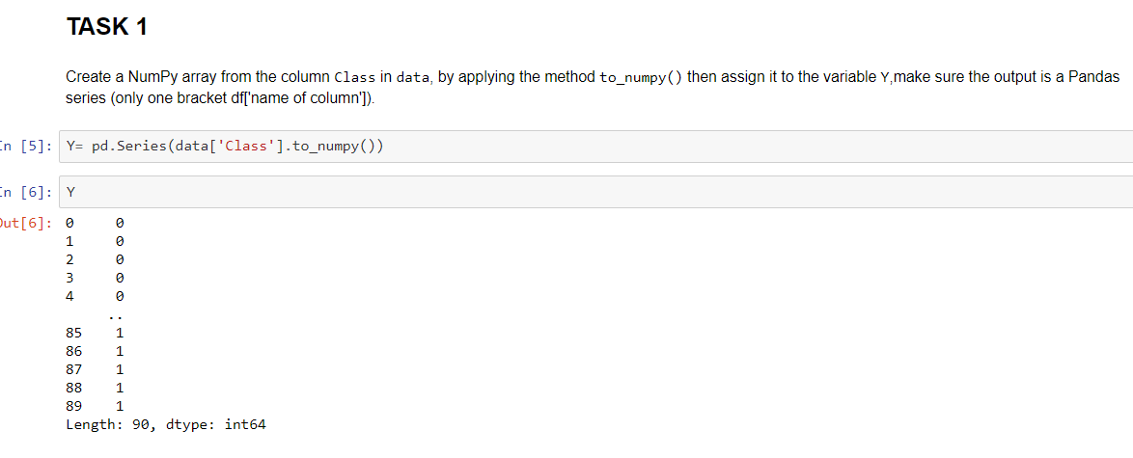
RESULT: predictive analysis (classification) : task 1

Slide 31
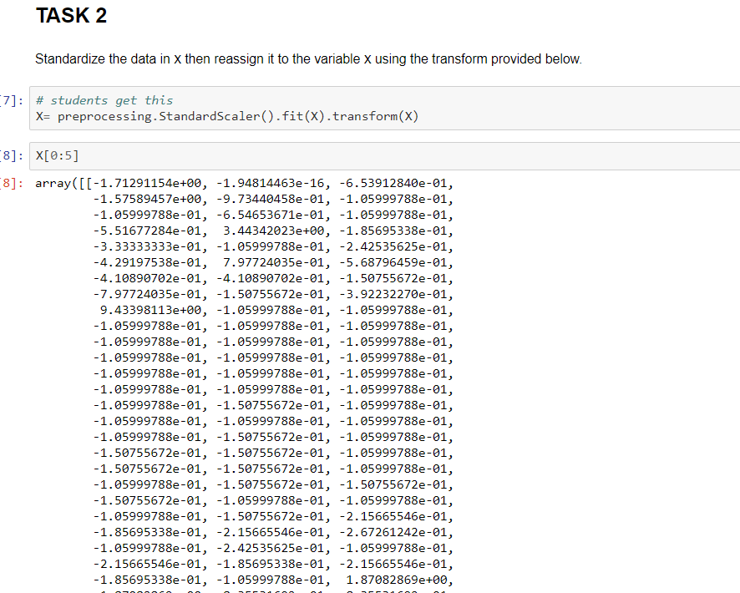
RESULT: predictive analysis (classification) : task 2

Slide 32
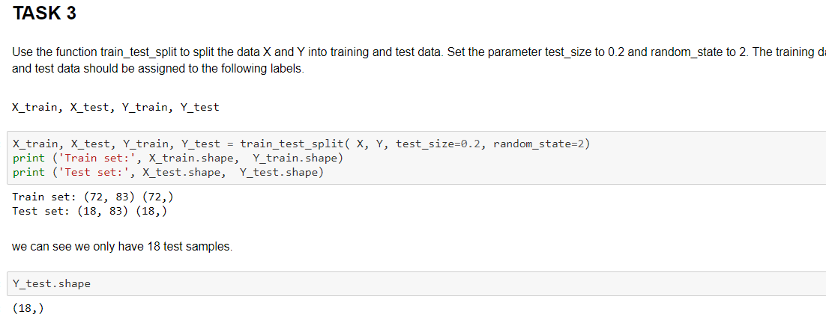
RESULT: predictive analysis (classification) : task 3

Slide 33
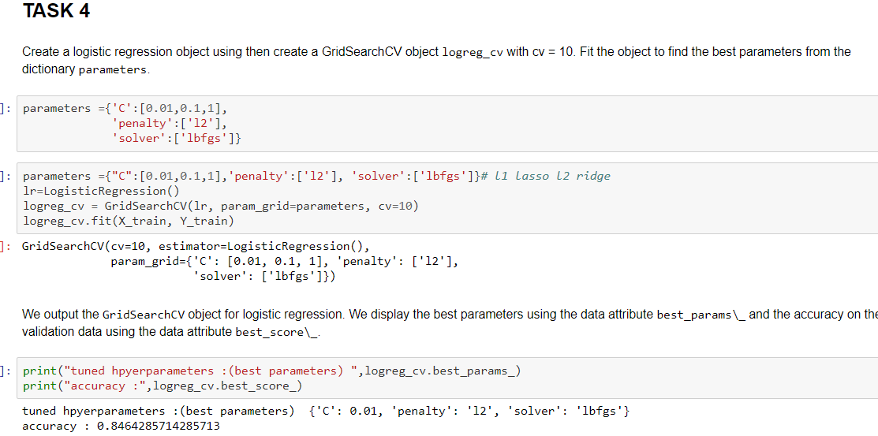
RESULT: predictive analysis (classification) : task 4

Slide 34
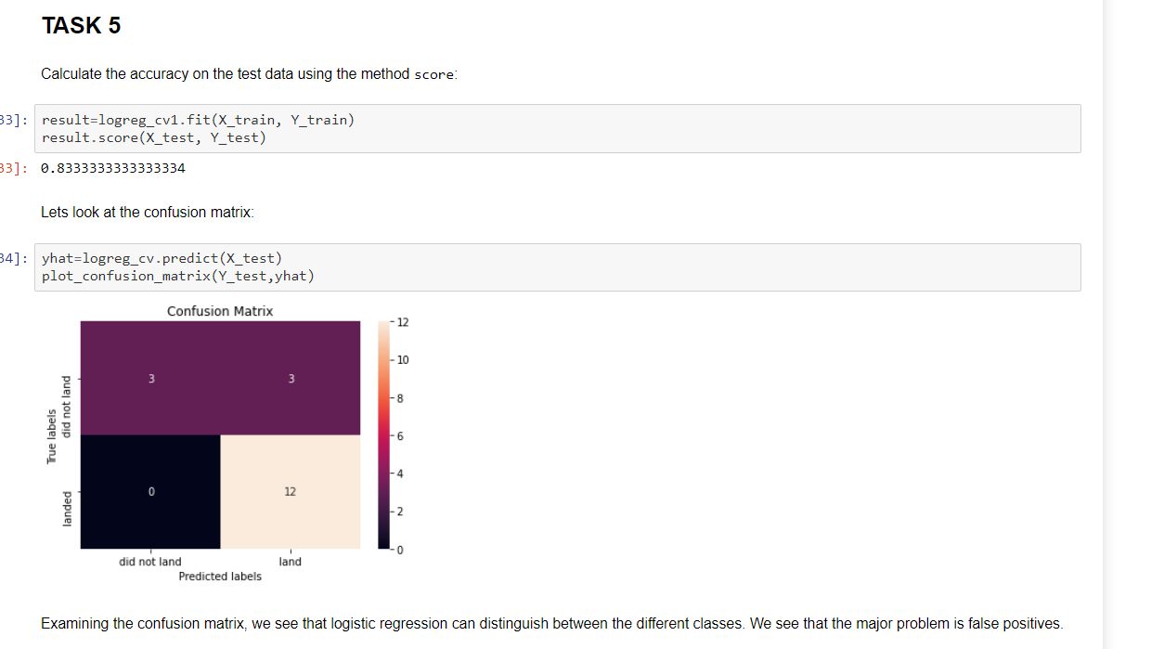
RESULT: predictive analysis (classification) : task 5

Slide 35
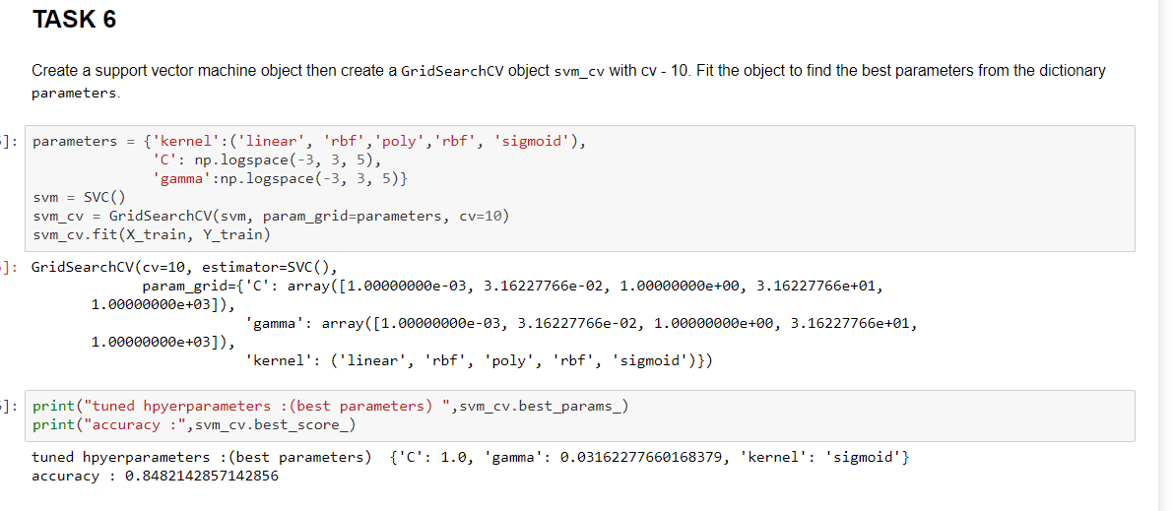
RESULT: predictive analysis (classification) : task 6

Slide 36
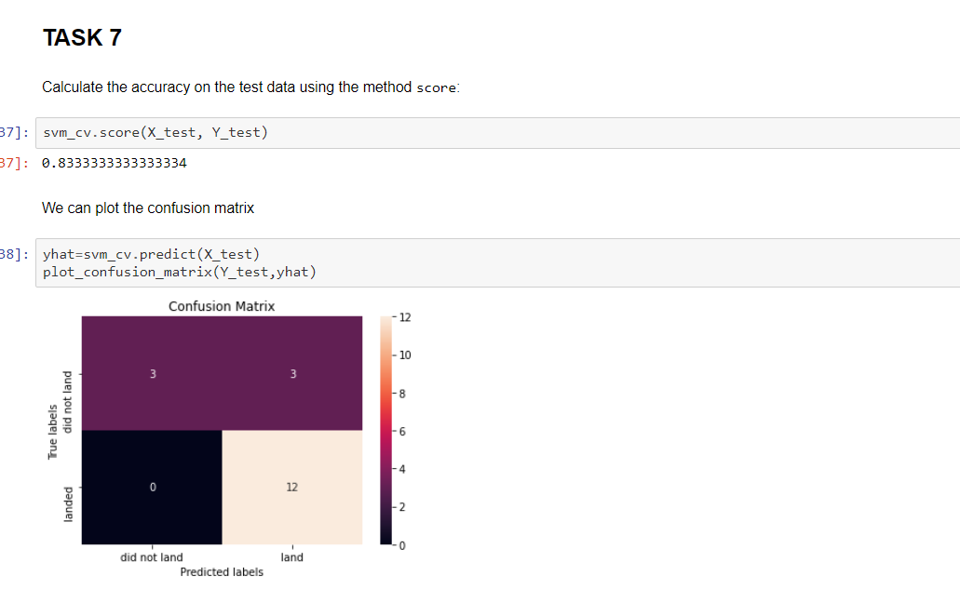
RESULT: predictive analysis (classification) : task 7

Slide 37
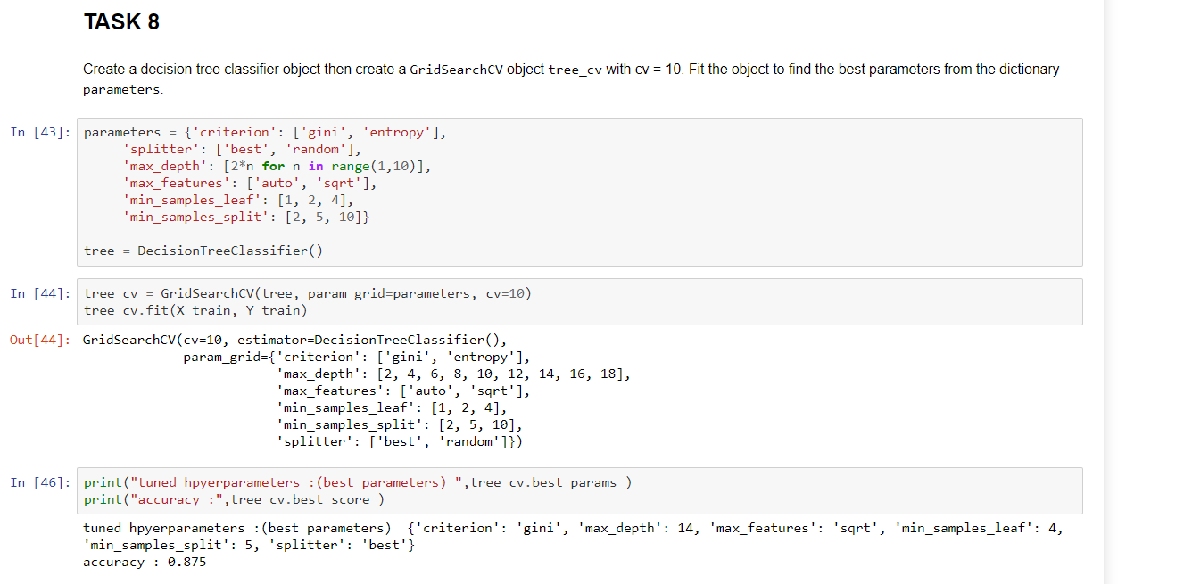
RESULT: predictive analysis (classification) : task 8

Slide 38
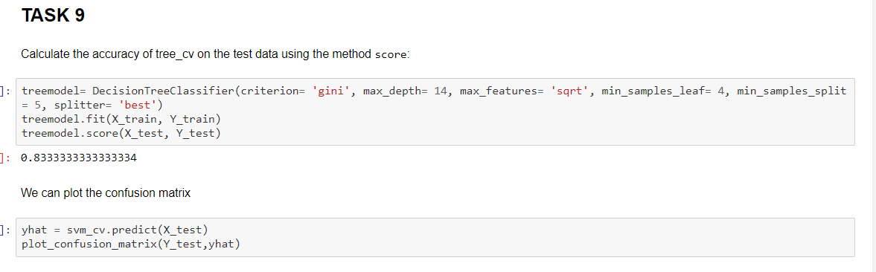
RESULT: predictive analysis (classification) : task 9

Slide 39
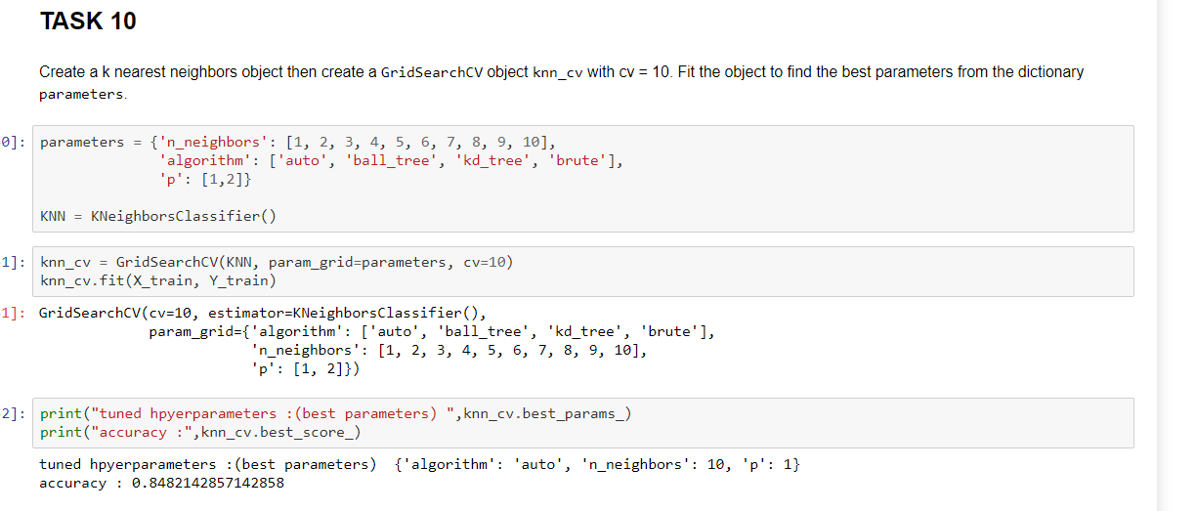
RESULT: predictive analysis (classification) : task 10

Slide 40
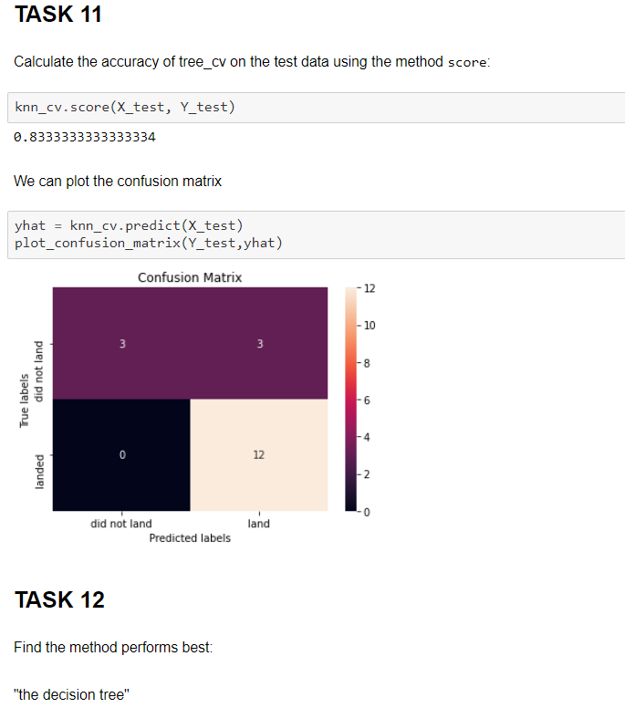
RESULT: predictive analysis (classification) : task 11 and 12

Slide 41

CONCLUSION
After an indepth review of data many the conclusion is that SpaceX claim that Falcon lower cost (62 million dollars) is because SpaceX can reuse the first stage has been confirmed.
The outcome of launching rockets has been increasingly successful as a result of reusing the first stage

Slide 42
APPENDIX
Increasing successful outcome over the years

Slide 43
GITHUB Link
This is the link to the github site with project material:
https://github.com/Robertboy18/IBM-Data-Science/tree/master/Applied%20Data%20Science%20Capstone

